Slide 1


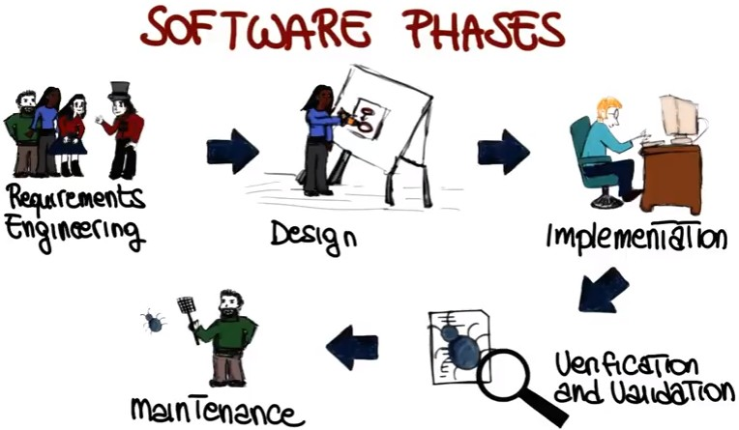
7/26/24
DA-IICT
IT 314: Software Engineering
Software Process Models - AGILE
1
Agile Software Development
Agile reduces the risk by delivering the value of the project very early

Slide 2
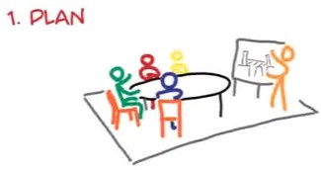
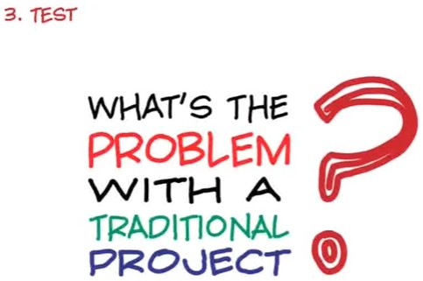
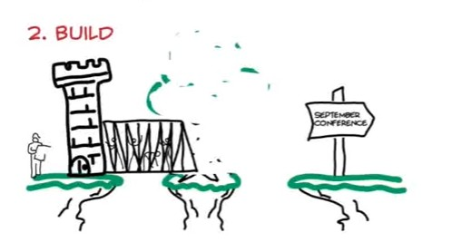

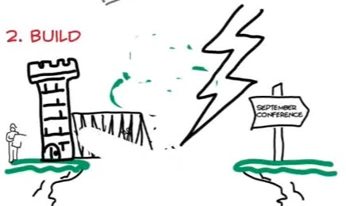
7/26/24
Agile Software Development
Traditional Software Development – Opposed to Agile
Agile Software Development

Slide 3
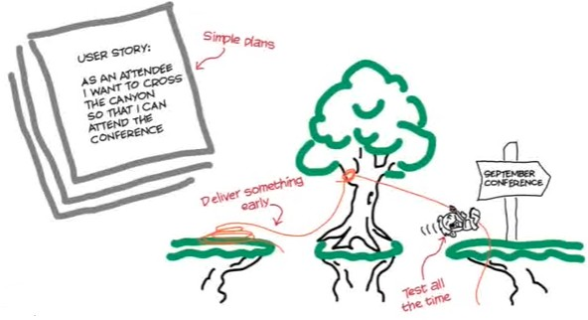
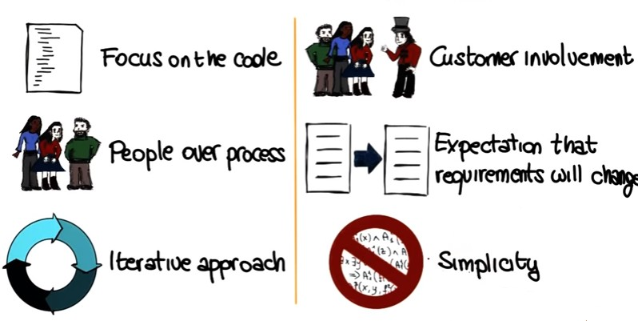
7/26/24
Agile Software Development
Agile Software Development

Slide 4
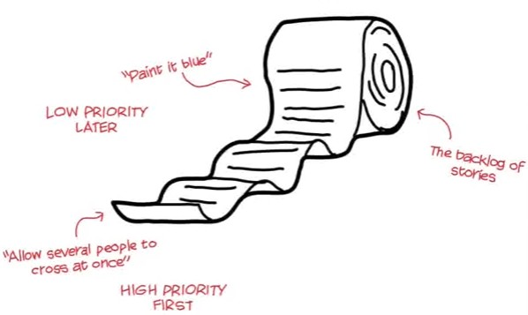

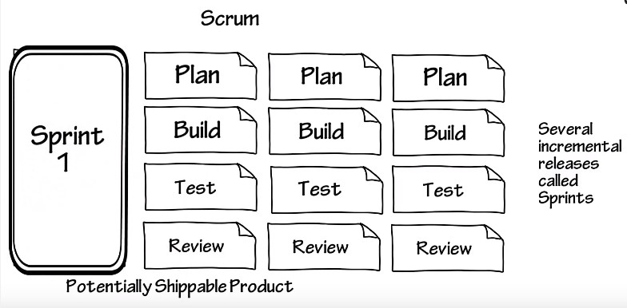
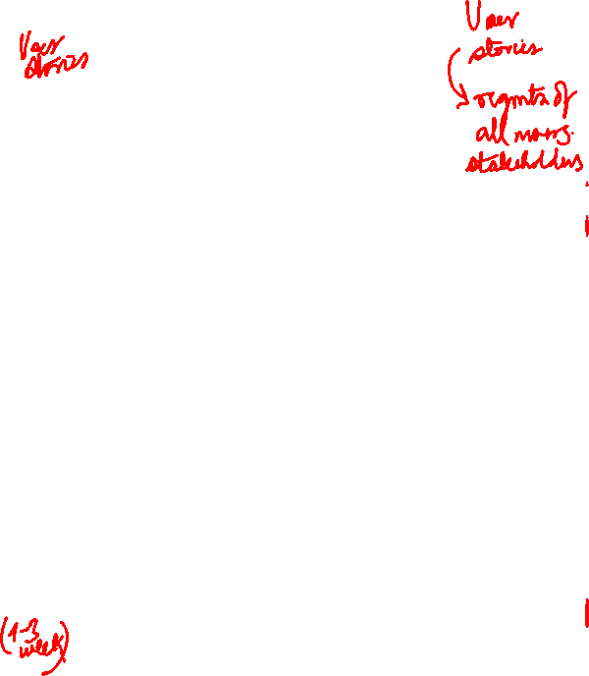
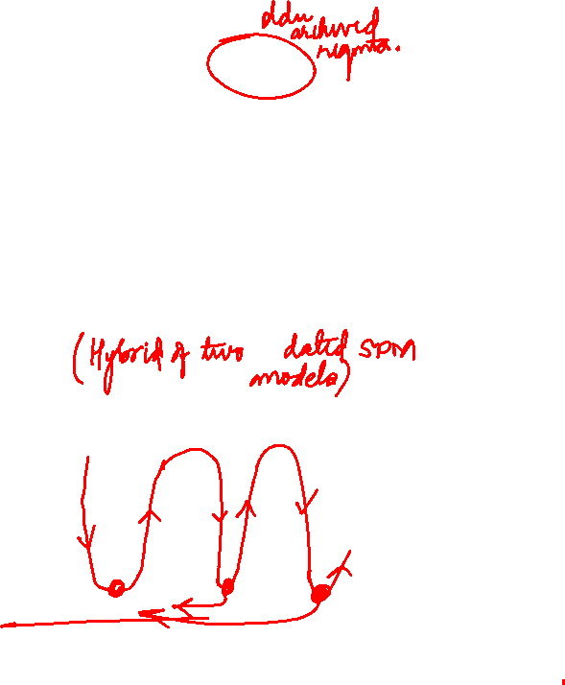
7/26/24
Managing Requirements - Agile
SCRUM

Slide 5
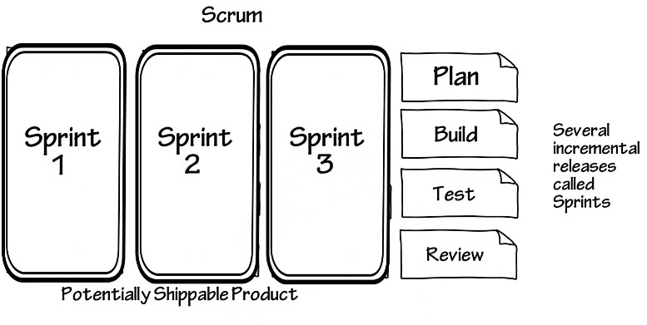
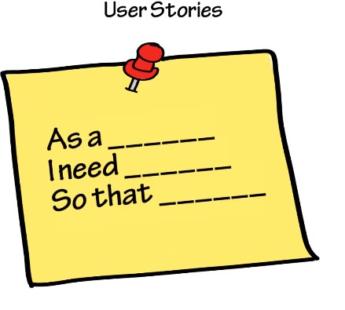


7/26/24
SCRUM
Specification - User Stories

Slide 6
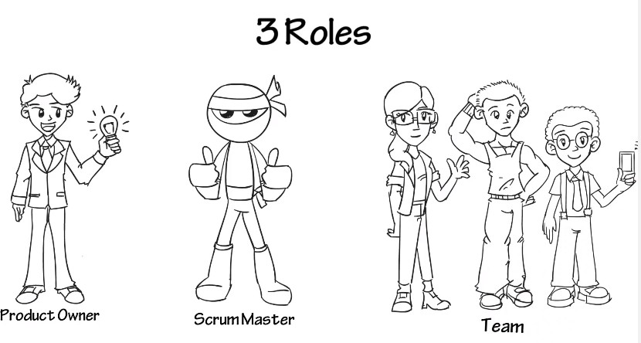
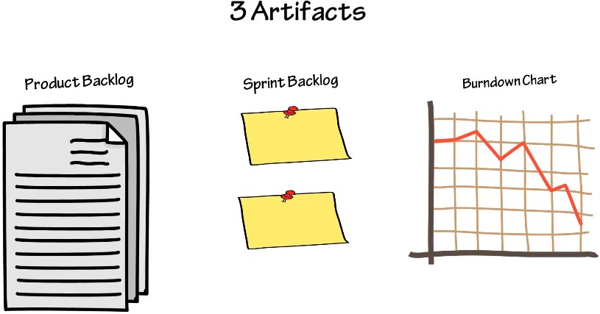
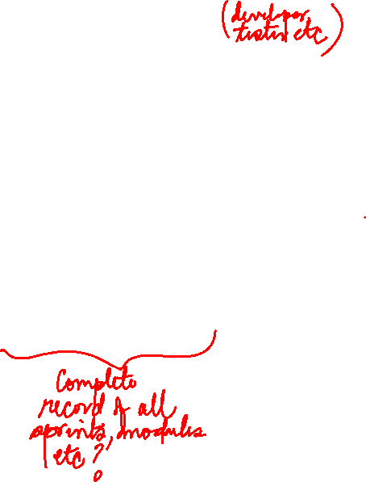

7/26/24
3R - SCRUM
3A - SCRUM

Slide 7
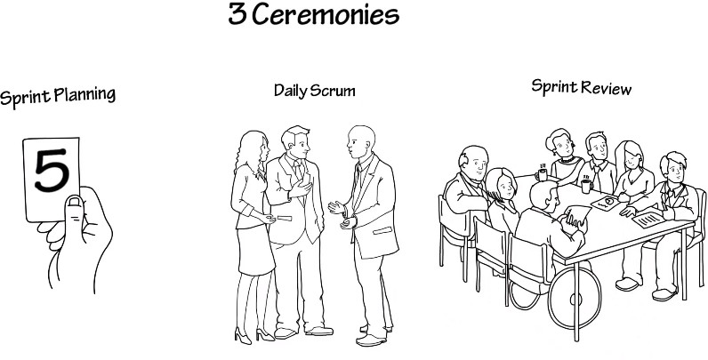
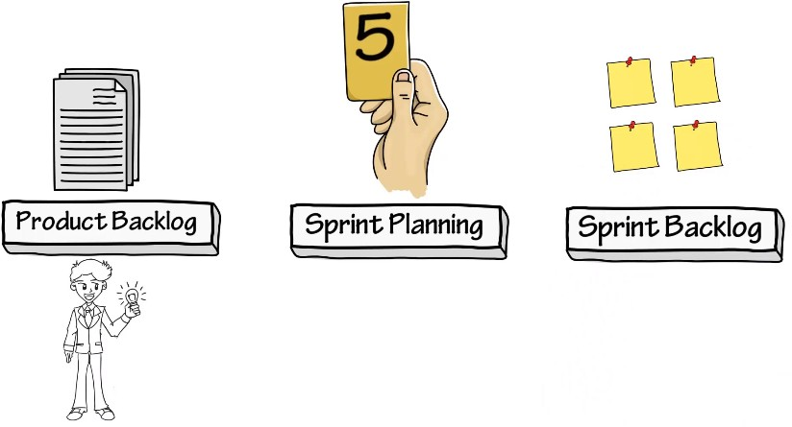
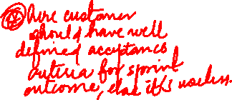
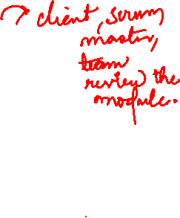
7/26/24
3C - SCRUM
SCRUM Process

Slide 8
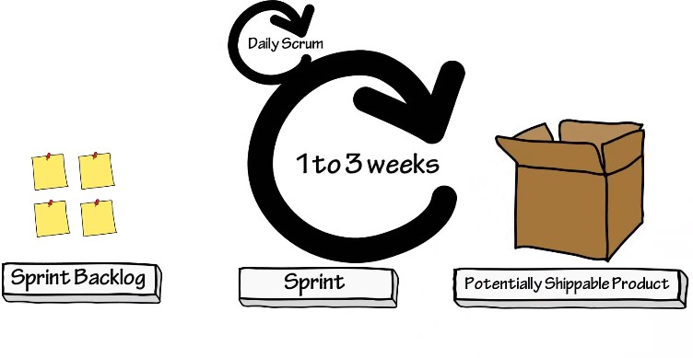
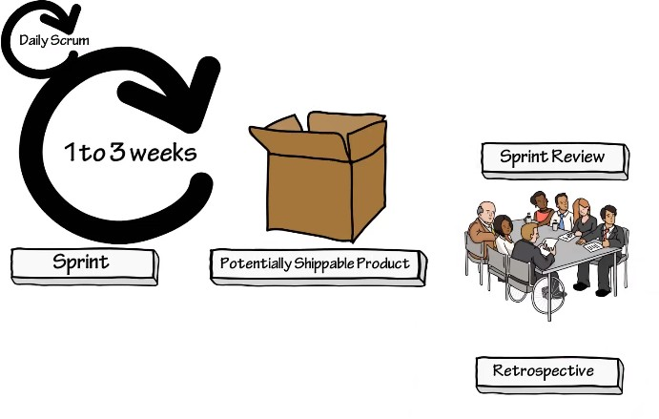
7/26/24
SCRUM Process
SCRUM Process

Slide 9
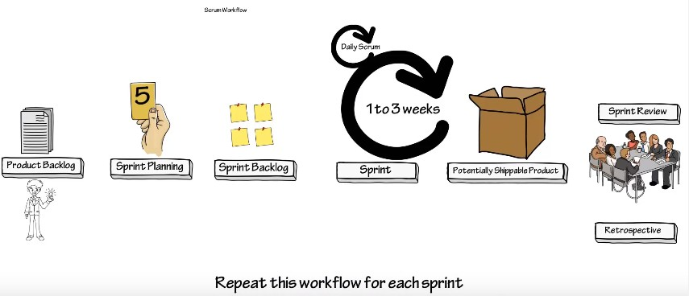
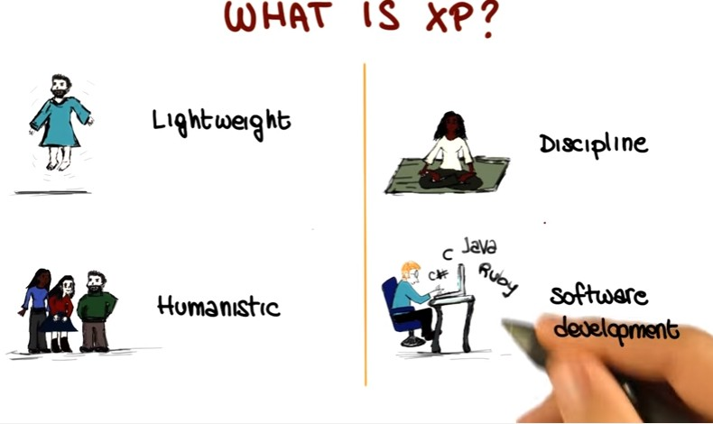
7/26/24
SCRUM
Agile

Slide 10
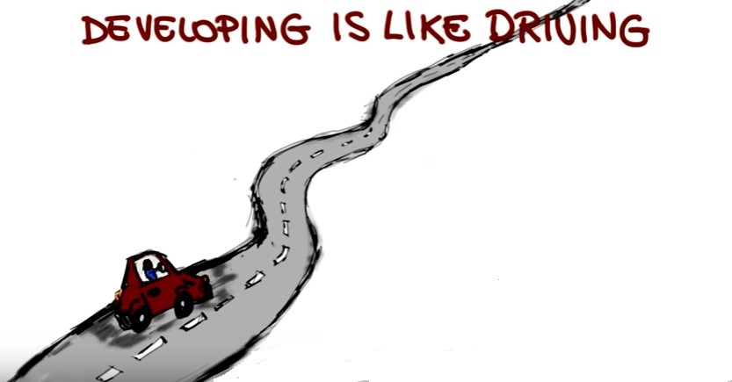
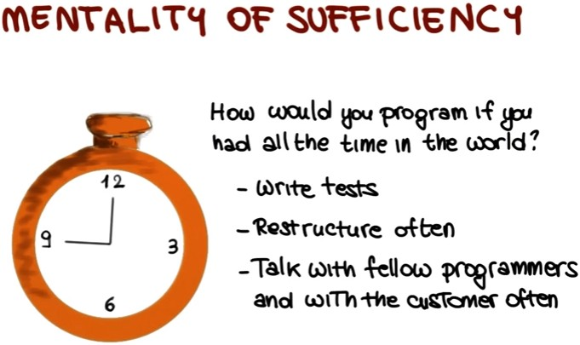
7/26/24

Slide 11
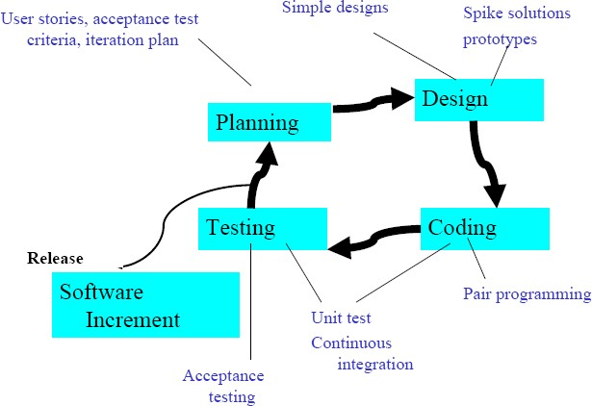
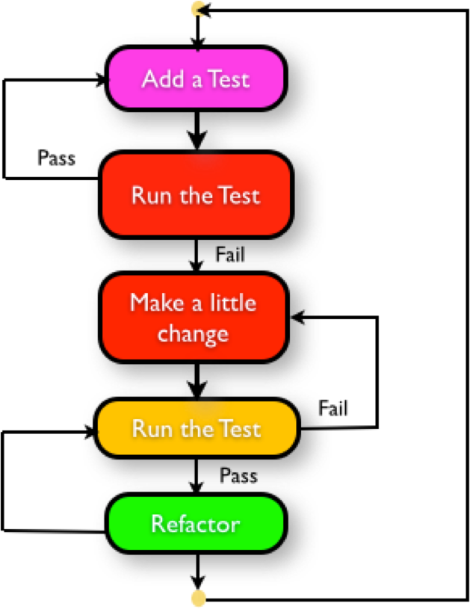
7/26/24
Extreme Programming consists of
Pair Programming Code Review Unit Testing
Integration Testing Planning Game Courage
Respect
TDD – Test Driven Development

Slide 12
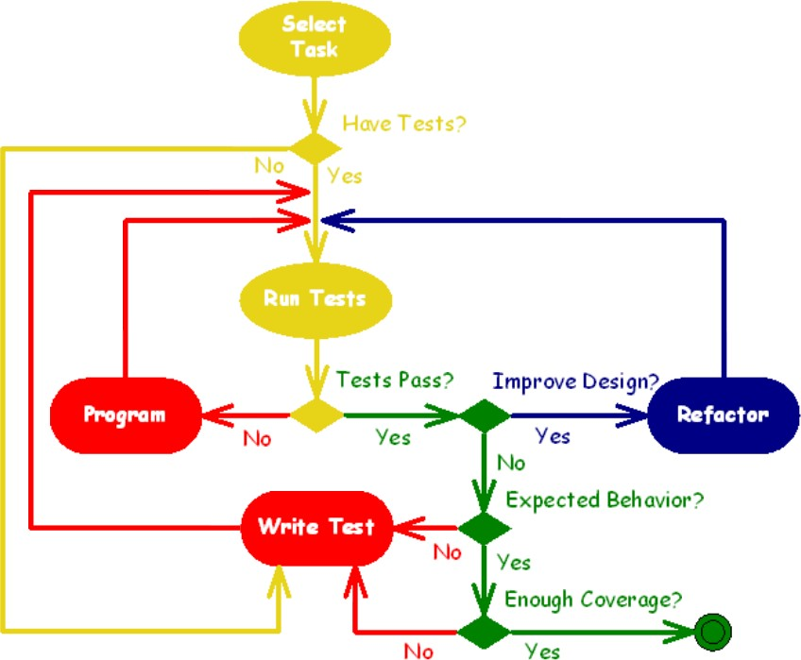
7/26/24
TDD – Test Driven Development
TDD – Test Driven Development
Test-driven development is not about testing.
Test-driven development is about development (and design), specifically improving the quality and design of code.
Cycle:
Write the test
Run the test (there is no implementation code, test does not pass)
Write just enough implementation code to make the test pass
Run all tests (tests pass)
Refactor
Repeat

Slide 13
7/26/24
TDD – Test Driven Development
Ensures quality
Keeps code clear, simple and testable
Provides documentation for different team members Repeatable tests
Enable rapid change
Questions??
Next Lectures…
Other Process Models
(RUP, Agile (XP) and so on…., CMM

